Slide 1

Database for Clinic Management
Teeratass Peyasantiwong 6480651
Milin Amornruttanadecha 6480303

Slide 2
Purpose:
Patient Records
Appointment
Management for Doctor, Staff, and/or Patients
Billing and Payments
Medical Test
Branch Management
Medication Inventory

Slide 3
Reminder:
Please overlook “Center Div”
Mockup UI is general

Slide 4
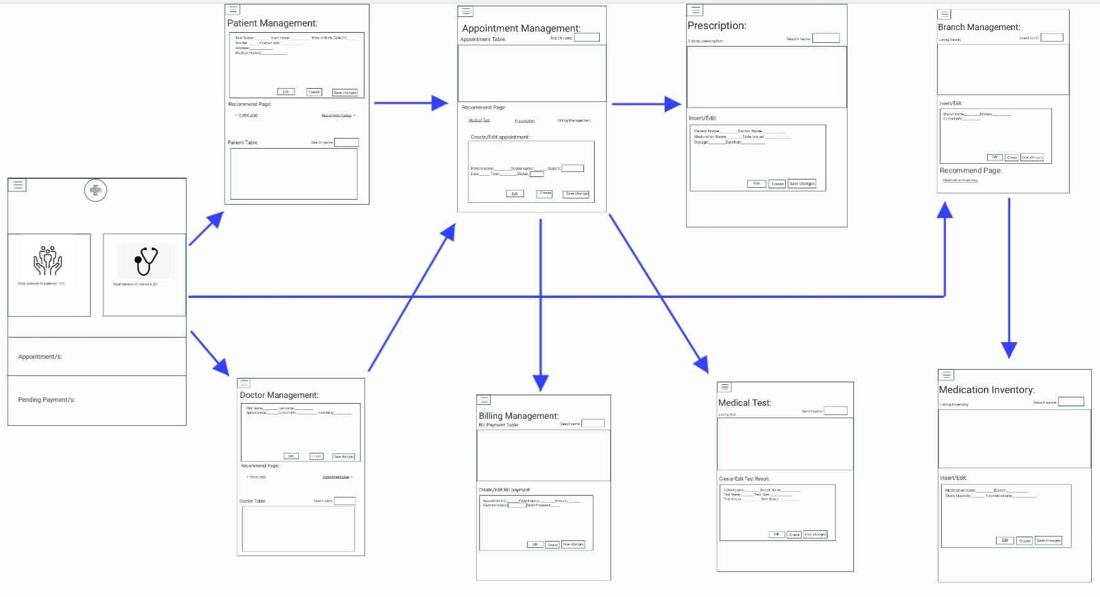
Site Map:

Slide 5
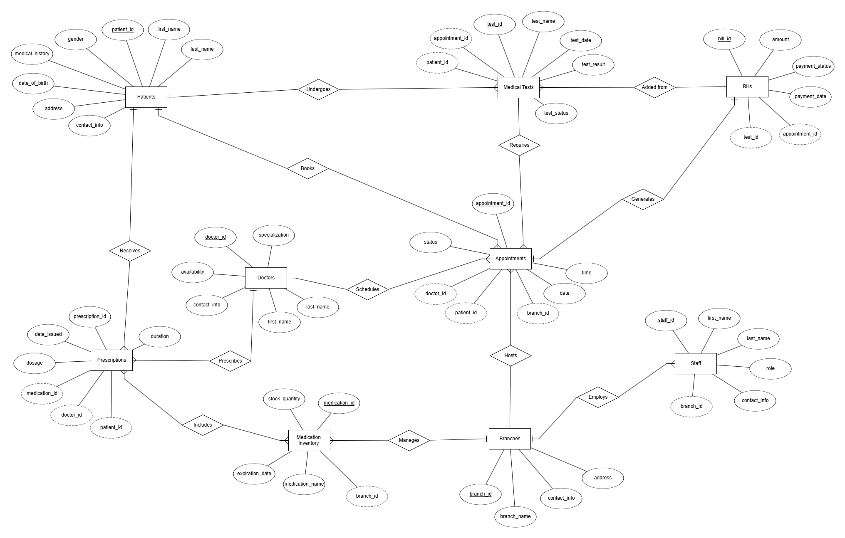

Slide 6
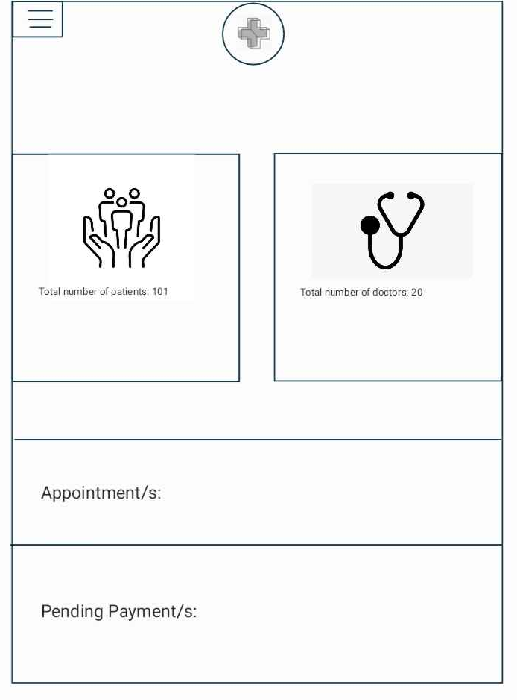

Home page
Number of Patients
Number of Doctors
On-going appointment/s
Pending Payment/s

Slide 7
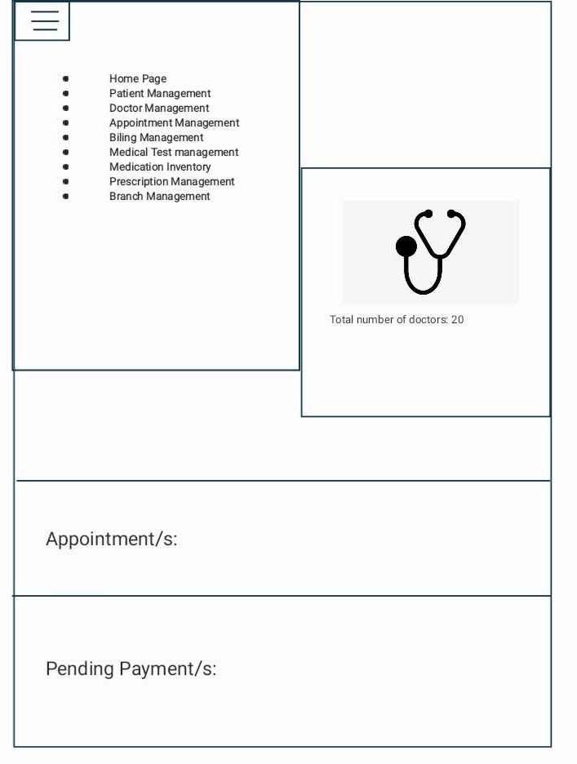
Home page
Number of patients
Number of Doctors
On-going appointment/s
Pending Payment/s

Slide 8
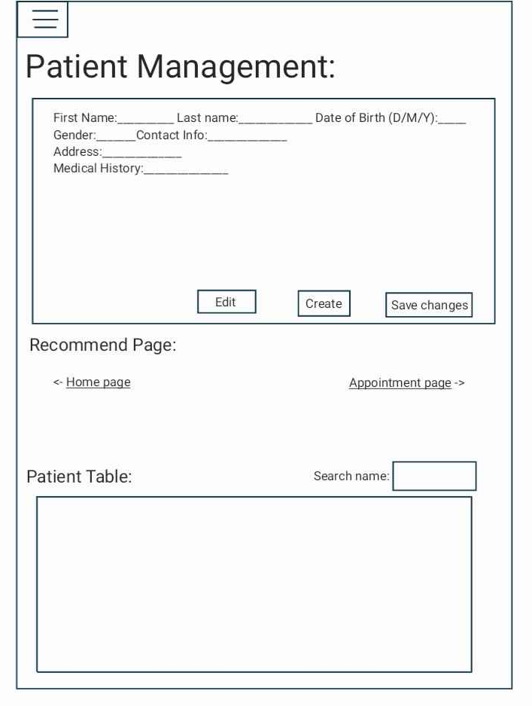
Purpose Manage Patient Records
Features:
Edit
Create
Search

Slide 9
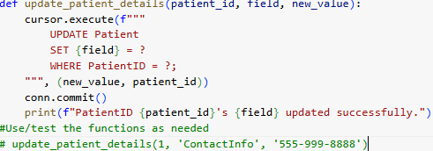
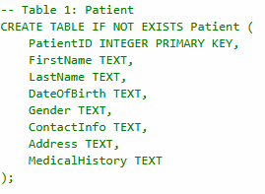


PatientID FirstName LastName DateOfBirth Gender ContactInfo Address MedicalHistory
0 1 John Doe 1980-05-15 Male 555-999-8888 Wolf Street 29 Diabetes

Slide 10
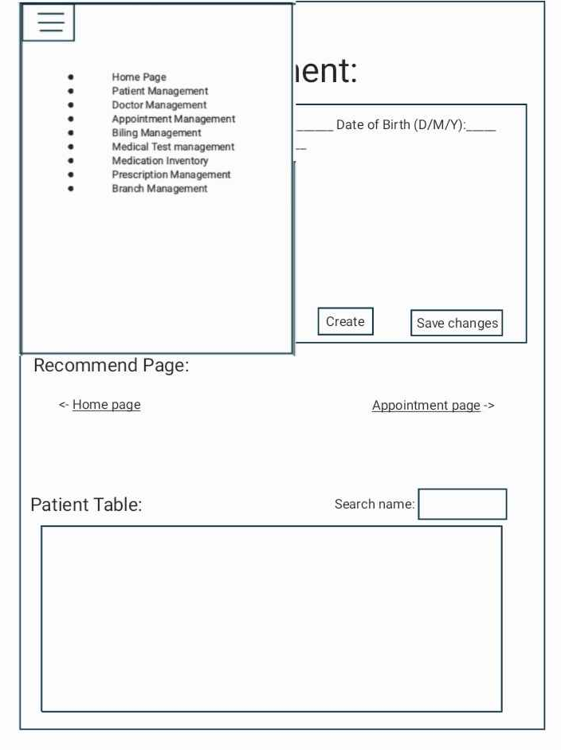

Slide 11
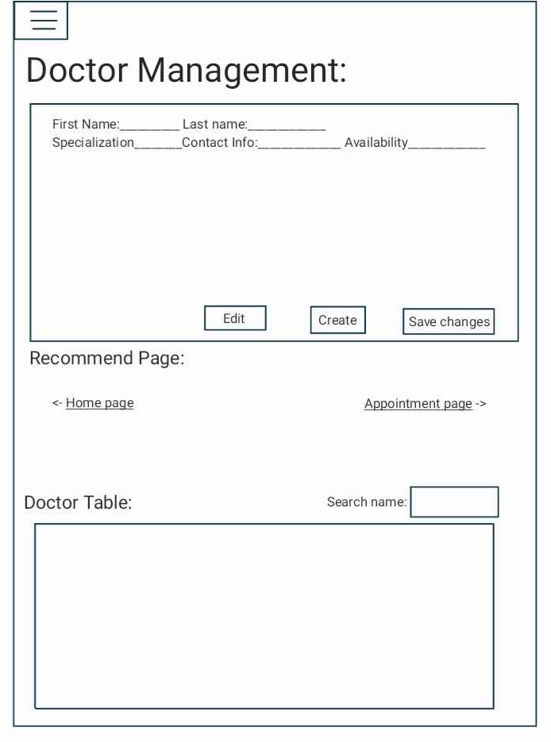
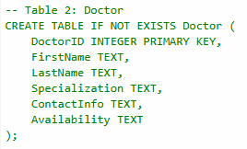




Purpose Manage Doctor Information

Slide 12
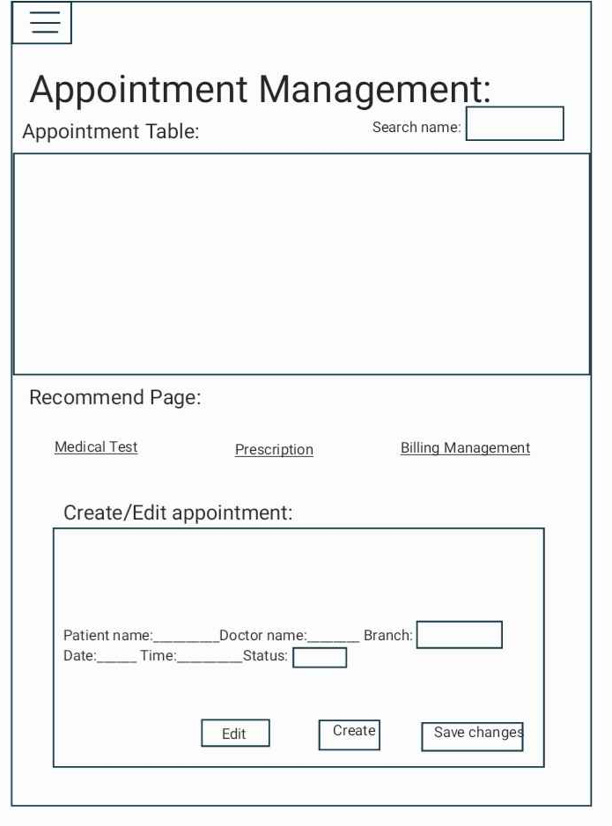


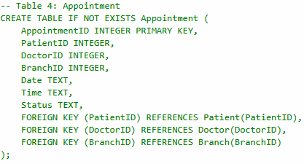



Purpose Schedule and Manage Appointments

Slide 13
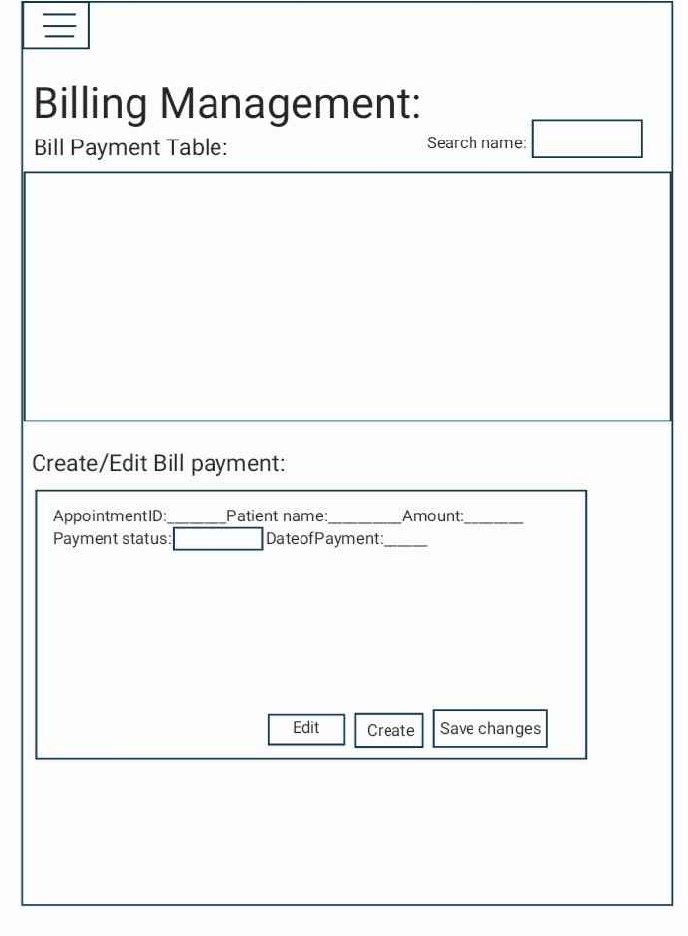


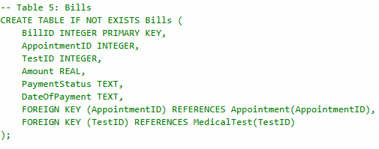


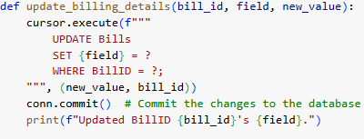
Purpose Manage Payments/Bills

Slide 14
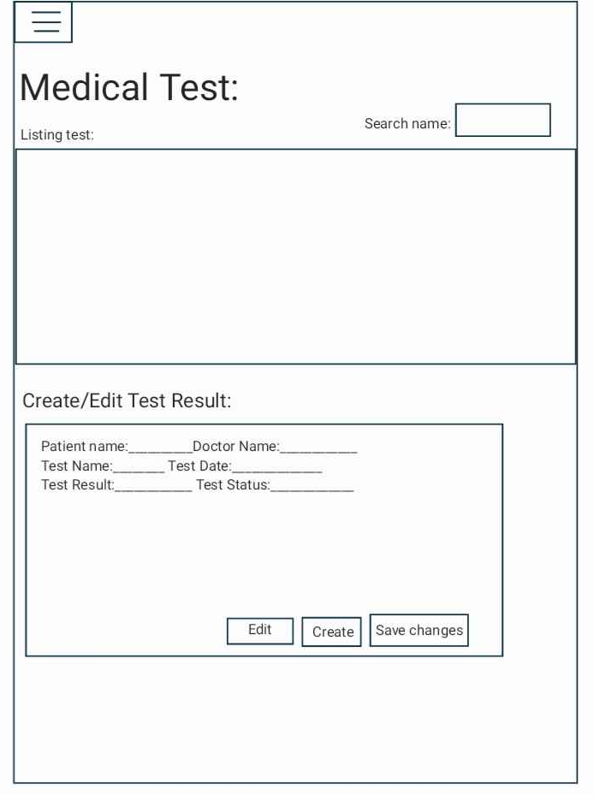


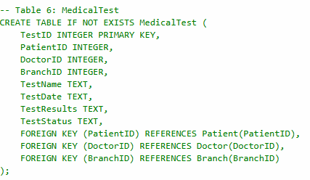


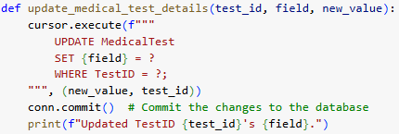
Purpose Manage Medical Test

Slide 15
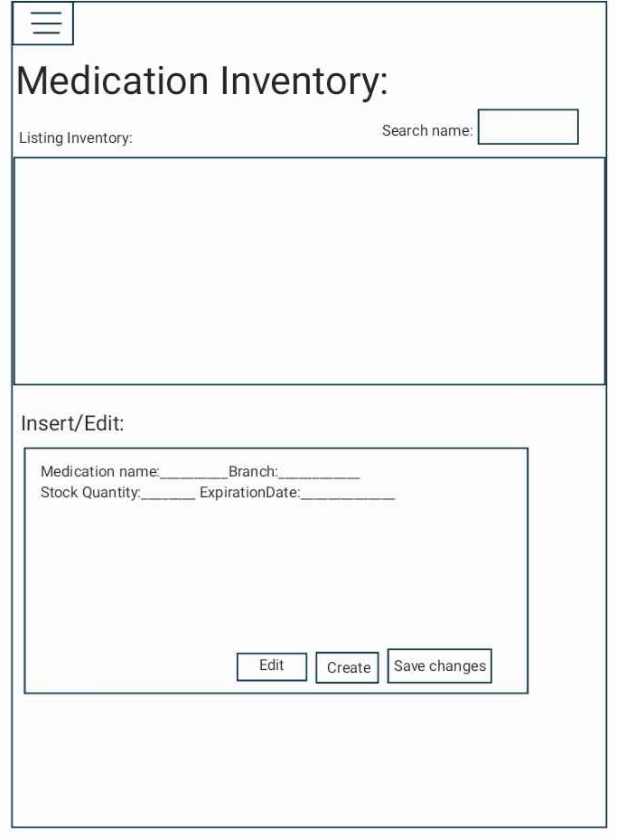


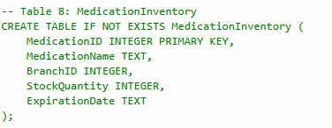



Purpose Track Medication in Each Branch

Slide 16
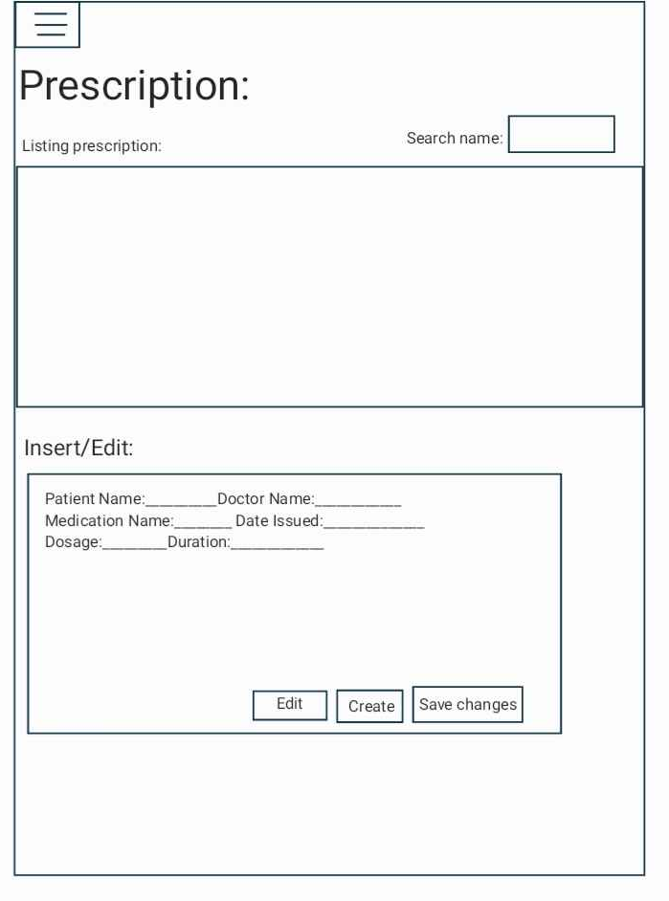


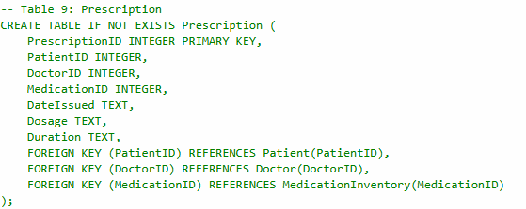



Purpose Manage prescriptions issued by doctors.

Slide 17
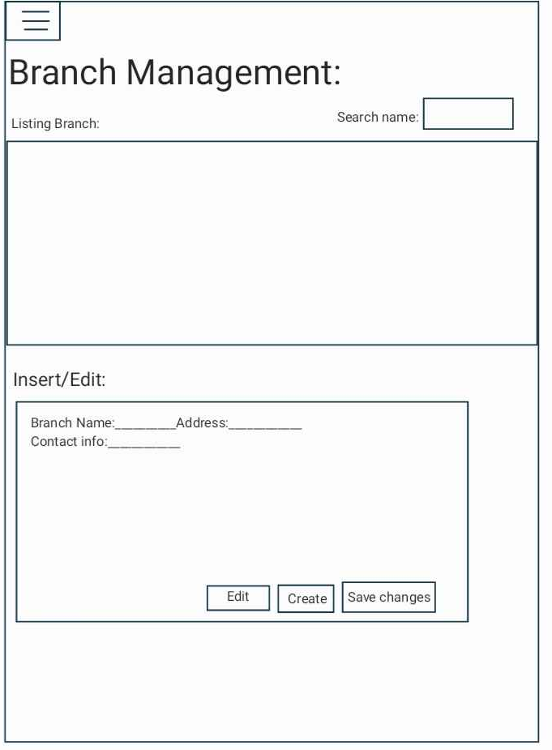


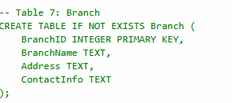



Purpose Manage clinic branches

Slide 18
Improvements:
Adding More Features(e.g. Delete)
Enhance Searching Tools (e.g. Filtering)
Coordinates/Map for Each Branch
Privacy for Users
Adding Photos and Videos for Medical Test

Slide 19
Thank You

